Slide 1
Planning for the new capital gains inclusion rate in Corporations
Chris Britton, CPA, CA, FEA

Slide 2
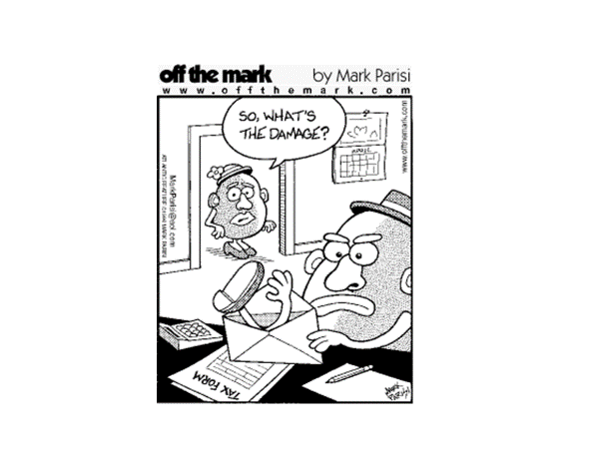

Slide 3
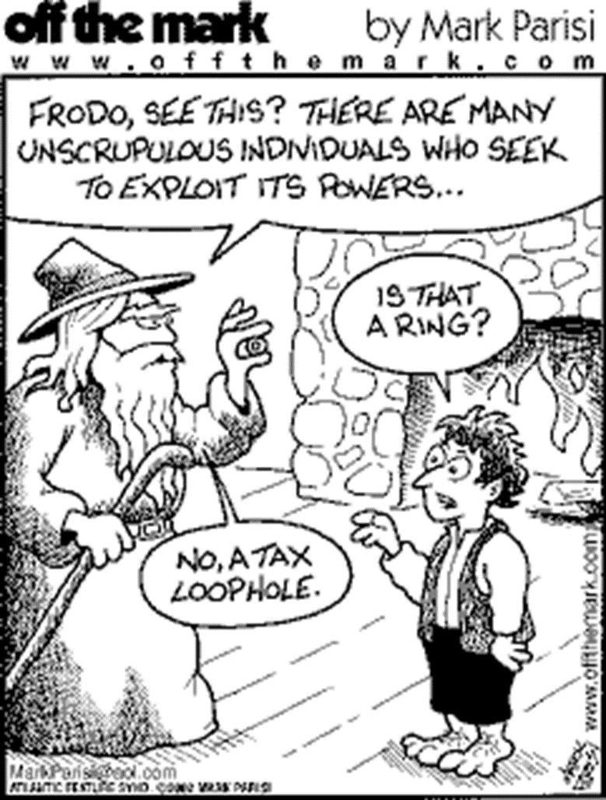

Slide 4
Theory of Integration
Should be no difference in after-tax compensation received by paying a salary or a dividend
Over integration – more tax paid with a dividend
Under integration – more tax paid with a salary
For years tax system was slightly under integrated on income subject to the Small Business Deduction (“SBD”)
Increased dividend tax has reversed much of the advantage to paying dividends

Slide 5
Active Income Integration – Ontario 2024

Slide 6
Tax Savings (cost) and Deferral By Province

Slide 7
Corporate Passive Income
Small business deduction (“SBD”) will be reduced for “adjusted aggregate investment income” (“AAII”) over $50,000
$50,000 calculated based on $1,000,000 earning 5%
Each $1 of investment income over $50,000 will reduce the SBD by $5
SBD = 0 if investment income exceeds $150,000

Slide 8
Integration – Passive Income Rules
Where integration exists the proposed passive income rules should only cost the “deferral advantage”
If provinces are over integrated there is also a true cost
Deferral advantage is significant
Every $1 of Adjusted Aggregate Investment Income (“AAII”) will cost 5 * deferral advantage
Ontario - $1 * 5 * 14.3% = 71.5% increased tax

Slide 9
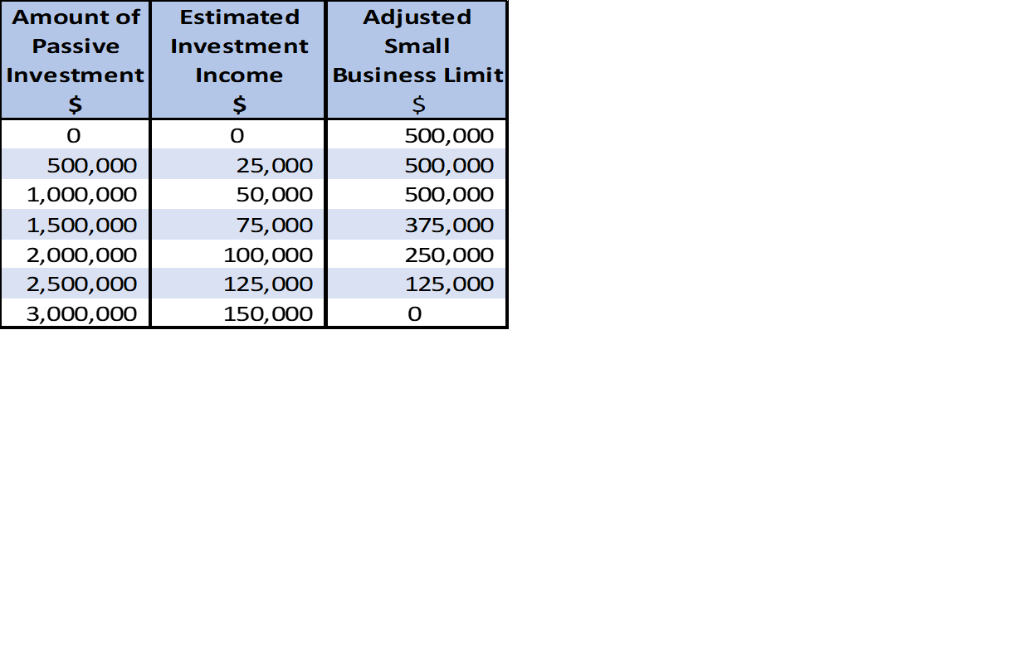
Passive Income Grind

Slide 10
Deferral Advantage

Slide 11
New Capital Gains Inclusion rules
For individuals, corporations and trusts the inclusion rate increased from 50% to 66.7% for capital gains effective June 25, 2024.
The first $250,000 of capital gains per year realized by individuals (whether directly or through a trust), qualified disability trusts and graduated rate estates remain subject to the 50% inclusion rate.

Slide 12
Corporate Capital Gains Tax
Loss of integration on the first $250,000 (“Individual only threshold”)
Tax rate increase and province/territory of residence:
Approximately 8% change in tax rate
Approximately 30% in relative increase in taxation of capital gains

Slide 13
Capital Gain Tax Rates - Individuals

Slide 14
Passive Income Integration – Ontario 2024

Slide 15
Passive Income Tax Rates - CCPC

Slide 16
Tax Savings (cost) on Passive Income By Province

Slide 17
Annual Compensation Planning
Owner-managers have annual lifestyle requirements
Most income splitting opportunities for non-active family members have been eliminated
Consider impact of paying dividends vs salary

Slide 18
Salary vs Dividend – Income Required for Lifestyle
Income subject to SBD is now virtually integrated
Income subject to general business tax rates is over integrated
Salary should be paid in almost all scenarios
Advantages
Less income tax on general business rate income
Increased “earned income”
Increased ability for registered plans (RRSP’s, IPP’s etc)
Reduces corporate income and potentially the business limit required
Potentially increased CPP benefit
Disadvantages
Potentially increased CPP and admin costs

Slide 19
Example – 2024 Ontario

Slide 20
Effect of Salary on AAII Grind

Slide 21
Income NOT Required for Lifestyle
Considerations:
When will owner-manager require the money?
Marginal tax rate in the future
What rate of return would be expected on the funds?
What is the level of AAII?
Strategies to Manage AAII annually

Slide 22
Tax Efficient Investments or Products
Types of income producing investments
Life Insurance

Slide 23
Types of Investments
Strategy to invest in products that limit or defer taxable income
Ie. Corporate class funds
Strategy for portfolio allocation to find stocks that pay low or no dividends and have capital growth
Don’t let the “tax tail wag the dog” for investment choices
Investment allocation can reduce impact of passive income rules

Slide 24
Portfolio – Interest/Dividend
Business limit grind for AAII greater than $50,000

Slide 25
Portfolio – Balance Portfolio
Business limit grind for AAII greater than $50,000

Slide 26
Life Insurance – Planning
Portfolio reallocation
Tax-free growth
Increase benefit by reducing AAII on passive investments
Proactive planning is required
New tax rules don’t allow lump sum deposits
Funds not required to be taken in retirement
Tax-free to corporation on death
CDA credit for Estate
Access to cash value while alive

Slide 27
Case Study
Assumptions: 40 year old Male non-smoker

Slide 28
Case Study – Grind to Small Business Deduction

Slide 29
Case Study
Explore allocating $100,000 per year for 25 years into a Par policy.
Assumptions:
Maximize ADO
Current dividend scale
Portfolio continues to have same investment mix

Slide 30
Case Study – Grind to Small Business Deduction

Slide 31
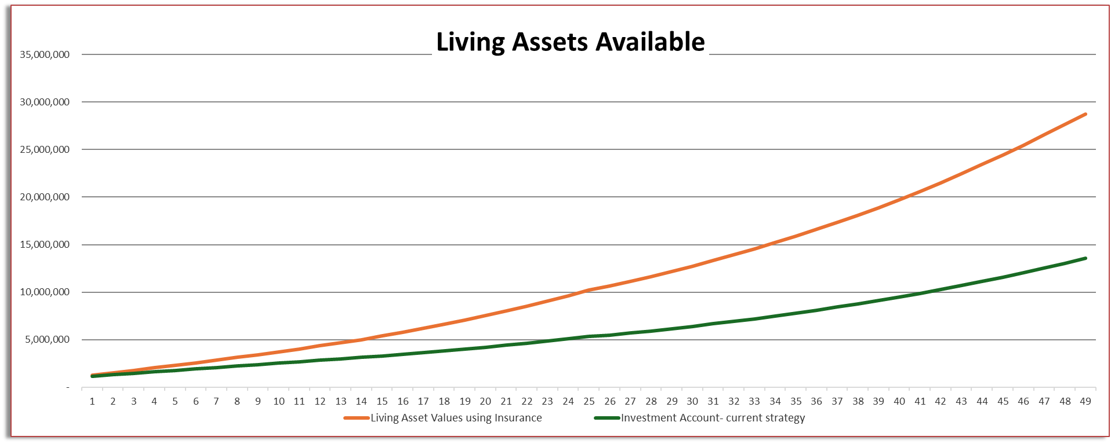
Case Study

Slide 32
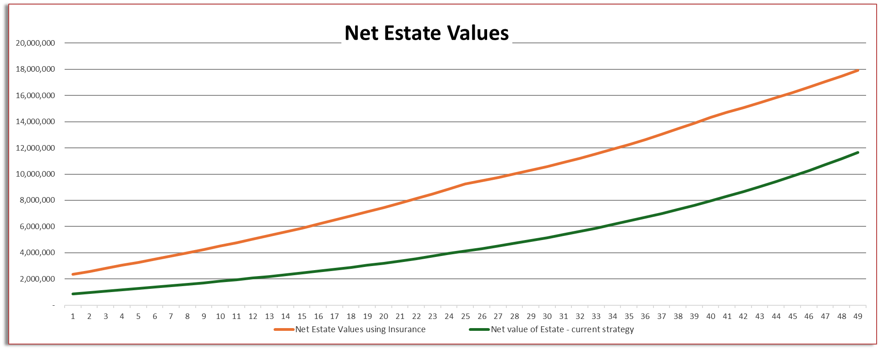
Case Study – Liquidated values to Estate

Slide 33
Questions?

